Slide 1
Stages of Team Growth
www.GlacierPointSolutions.com

Slide 2
Team Member Role
Contribute fully
Provide new ideas
Protect new ideas
Share tasks equally
Listen well
Seek to understand other points of view
Share tasks
Facilitate team behavior

Slide 3
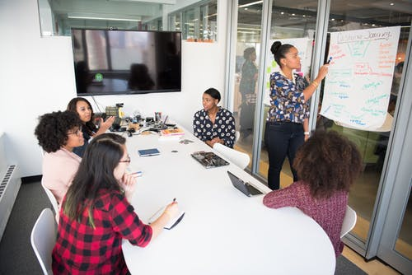
Leader Role
Coordinate meetings
Keep meetings on track
Set agenda
Create a positive, supportive climate
Maintain momentum and group morale
Protect new ideas
Delegate tasks

Slide 4
Stages of Team Growth
Forming
Storming
Norming
Performing*
*Tuckman’s Model for Nurturing a Team to High Performance

Slide 5
Stages of Team Growth
Forming
-Getting acquainted
-Uncertainty around roles & goals
-Formal approach to work meetings & tasks
-Establishing Ground Rules
Storming
-Not feeling like part of team
-Resist control by leader
-Communicating feelings
-Show hostility, frustration, or discomfort
Norming
-Feeling part of a team
-Establishing group norms
-Optimism regarding goal attainment
-Accepting and synthesizing various viewpoints
Performing
-Trusting
-Flexibility
-Feeling equal
-Supporting each other
-Efficiently making decisions
-Accepting failures
-Celebrate successes

Slide 6
Forming
Excitement, anticipation, optimism
Pride in being chosen
Tentative attachment to the team
Apprehension, suspicion, fear, anxiety
Behaviors Observed
Attempts to define the tasks
Attempts to determine acceptable group behavior
Abstract discussions of concepts and issues
Complaints

Slide 7
Storming
Resistance to the task
Sharp fluctuations in attitude about the team’s tasks and goals
Confusion
Frustration
Animosity
Behaviors Observed
Arguing
Defensiveness
Perceived pecking order
Questioning
Unrealistic goals

Slide 8
Norming
A new ability to express criticism constructively
Acceptance of membership in the team
Relief that it seems everything is going to work out
Behaviors Observed
Attempts at harmony
More friendliness and confiding in each other
A sense of team cohesion
Maintaining Ground Rules

Slide 9
Performing
Satisfaction
Calm
Energy
Behaviors Observed
Insights into personal and group process
Ability give and receive feedback
Constructive self change
Understanding and accepting of each other’s strengths and weaknesses
Satisfied with the team’s progress
Collaboration
Synergy, creativity, innovation, protecting new ideas
Ability to prevent problems
Close attachment to the team

Slide 10

Movement Between Stages
Movement through the stages is not linear. A team can get to Norming and fall back into Storming or move back and forth between stages.
The goal is to stay in Performing as much of the time as possible.
Forming
Storming
Norming
Performing

Slide 11
Roller Coaster of Highs and Lows
Lows New members join Members leave False starts New tasks Failures Impatience Encountering resistance Mistakes | Highs Creating a good plan Accomplishments Overcoming barriers Good information Shows of support from others Understanding Connection

Slide 12
Strategies to Move Toward the Performing Stage
Share a strong sense of purpose
Delegate tasks effectively
Build mutual accountability
Build consensus for decisions
Manage conflict effectively
Evaluate the team
  Create actions to help the team move toward Performing
  Give positive reinforcement for good team behaviors
  Give constructive feedback where needed
  Help the team give itself constructive feedback
Get acquainted and build trust by participating in team building activities
Celebrate successes

Slide 13
Establish a High Performing Team by Putting the Following in Place
In order of importance:
  Roles – who does what
  Goals – what the team is focused on accomplishing
  Policies & Procedures –
    What they do
    How to do it
    Guidance for team interaction
  Relationships – build trust and interdependence
  Leadership – an effective leader who gives positive and constructive feedback and is focused on building a high performance team

Slide 14
Summary
Stages of Team Growth
  Forming
  Storming
  Norming
  Performing
  Goal: to be in the Performing Stage as much as possible

