Slide 1
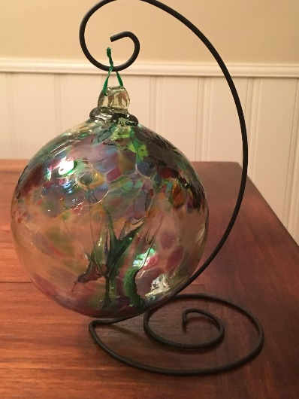
Glacier Point Solutions, Inc.
All Hands Meeting
November 4, 2019

Slide 2
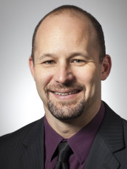
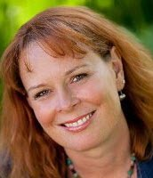
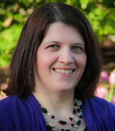
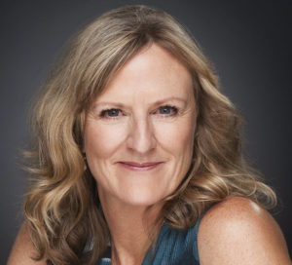

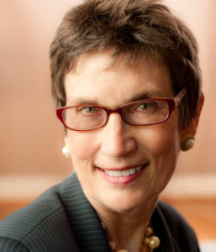
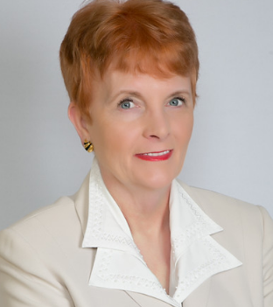
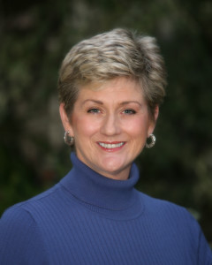


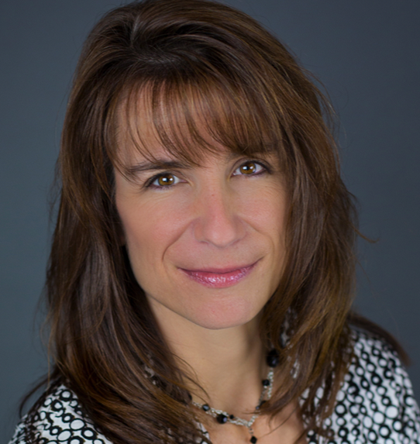
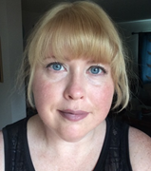
Glacier Point Solutions, Inc. - Team

Slide 3
Meeting Agenda
Neuroscience of Coaching – J. Matthew Becker 50-60 Min
Professional Development Information 10 Min.
  Closure Process Experiences
  Sources of CCEUs
Glacier Point Solutions, Inc. - Business Overview 20 Min

Slide 4
Closure Process
Any experiences with the Closure Process you can share?

Slide 5
Sources of CCEUs
Use GPSI Meetings as Resource Credits or Independent Study
Events calendar for ICFLA: http://www.icfla.org/Public/Events/ (SIGs count too)
ICF SIGs
ICF Orange County: https://icforangecounty.org/meetinginfo.php
ICF Phoenix: http://icfarizona.org/events
Other courses: https://www.effectivevirtualconversations.com/virtualfacilitationessentials.html
ICF videos:
  https://www.gotostage.com/channel/4d778ef341c74e778a7072fb7a1bd55b
  https://apps.coachfederation.org/eweb/DynamicPage.aspx?Site=icf&WebKey=176bcf86-a2d2-461a-9c26-e8290ab01bb6

Slide 6
Sources of CEUs
ICF - Professional Development
Performing Training
Serving as an instructor of ICF-approved training (letter from your supervisor on the training organization’s letterhead with the name of the course, date and amount of hours taught)*
Mentor Coaching
Serving as a Mentor Coach and/or supervisor (letter including the client name, contact information, dates and number of hours completed)
Special Projects
Special projects and activities approved in advance by ICF (dependent upon the agreement made with ICF staff when your special project or activity is approved)

Slide 7
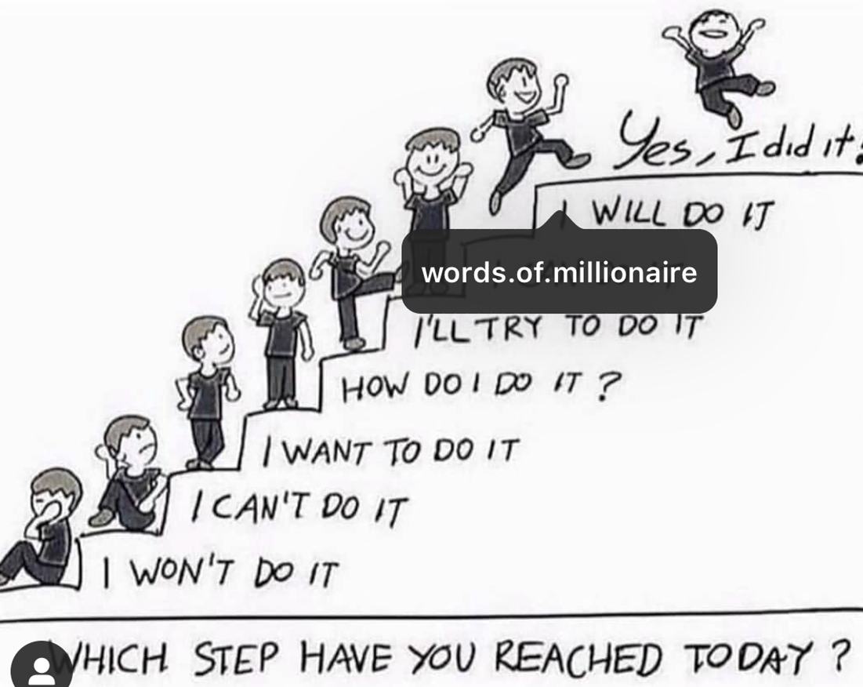

Slide 8
Glacier Point Solutions, Inc. - Business Overview
Close Rates
Average Coaching Effectiveness Survey Score
Length of Engagement
Celebrate - GPSI & Coach Accomplishments!

Slide 9
Close Rates – Individually Paying Clients
1Q-2Q17: 48%
3Q17: 46%
4Q17: 64%
1Q18: 71%
2Q18: 56%
3Q18: 69%
4Q18: 50%
2018: 62%
1Q19: 60%
2Q19: 50%
3Q19: 60%
  Goal Close Rate: 50%

Slide 10
Coaching Effectiveness Surveys – As of Q319
Overall: 4.69 out of 5* (Has increased from 4.5)
  Significantly above “Very Satisfied”!
Corporate Clients: 4.66 out of 5*
Individual Clients: 4.76 out of 5*
AeroVironment: 4.43 out of 5*
LBS FCU: 4.82 out of 5*
*3.2 out of 5 is Satisfied. 4.2 out of 5 is Very Satisfied

Slide 11
Length of Engagement Statistics
Overall: 7 Months
Individual: 5 Months
How can we improve this?

Slide 12
Client – Client Information Sheets
3Q19: 14%
1Q19: 40%
In Coaching Session: Get most of the information verbally and share with Angela

Slide 13
Positive Anecdotes and Comments About Coaches
Chris: One of Chris’ Leadership clients was walking through the parking lot, and a person came up to him, introduced himself, and shook his hand. He said it was humbling.
He is gaining a reputation as being transparent, asking for his team’s input. He said it felt really good that his reputation is spreading.
He also credited coaching with helping him become more self-aware of the impact he has on the organization—good and bad. And, he’s making changes based on this knowledge.
Katie: He has elicited feedback from multiple people at work - and he is getting great feedback of controlling his behavior and overcoming the concerns his boss had originally.
He is using deep breaths and pausing to get focused and communicate more effectively.
He said coaching has allowed him to stop and be more effective.

Slide 14
Positive Comments About Coaches
Ariana: “I feel that I have grown tremendously professionally and with her guidance, I have achieved a position I really wanted. You are incredibly good at what you do and I thank you for all of your time and patience. Coaching has been one of the best professional experiences I have ever had.
Charissa: “Through working with Charissa, she helped me find a process to identify my key personal and career strengths and characteristics, learn a system to sorting through exploring possible career options & activities that'll also help me with personal growth. I gained confidence in myself and my choices as a whole. I implemented additional methods to continue my personal growth and overall mental wellbeing.”

Slide 15
Positive Comments About Coaches
Jeannie: “Jeannie has some great attributes. I think our personalities and backgrounds are exceptionally well matched, but not to the point where we lack differing viewpoints. When we have our calls she is highly engaging and does a great job challenging me and making me look at things through different lenses. We all get stuck with our individual “confirmation biases” from time to time and her method to help me look at work and development situations differently is ENORMOUSLY helpful. “
Plum: “Plum is great at listening and analyzing the cases we talk about. She is very open and I can tell her anything I want directly to her.”

Slide 16
Coach Accomplishments

Slide 17
GPSI Administrative Accomplishments
Finished Budgeting with LBS FCU
DonnaSchilder.com
  Continue to implement Yoast.com
  Continue to implement WP SEO Schema to improve SEO.
  Initiating modernization redesign
  Continued to Blog
Started posting series of Videos on Leadership Assertiveness that I made with Sherri Cannon
  Posting on LinkedIn
  Posting on Blog
Created an Our Team Page – more casual

Slide 18
GPSI Administrative Accomplishments
Referral Partnerships continue to refer:
  Donna Svei – Executive Resume Writer
  Dawn Bugni – Resume Writer
  Jacqui Barrett-Poindexter – Resume Writer
OnBoarding - Social Media/Website Virtual Assistant
Building Instagram followers
LinkedIn
  Hiring a second consultant to support improving our LinkedIn presence
  Getting clients from LinkedIn again!
Created Social Media Templates

Slide 19
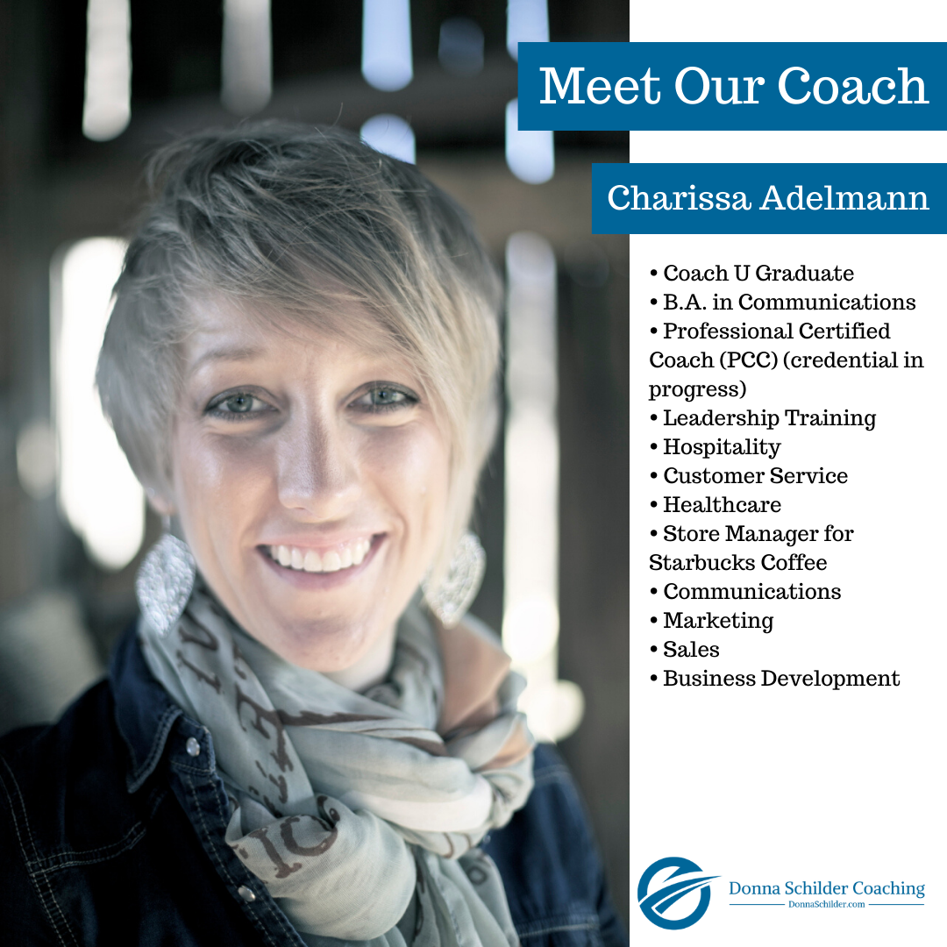
Marketing You on Social Media (LI, FB, IG, TW)

Slide 20
Streamlining Processes
No longer doing surveys for Individually Paid clients or small corporate contracts
Reduced types of Coaching Marketed:
  Leadership / Executive
  Career Exploration & Management
  Job Search
  We will work with other types of Coaching clients if we are qualified to do so

Slide 21
Glacier Point Solutions Corporate/NonProfit Projects
AeroVironment - Mid-Cap Publicly Traded Aerospace Company
  October – Coaching CEO + 9 Leaders
LBS FCU
  Continued to Coach 9 clients
Other Credit Union
  2 Clients – received extensions on both
Bearing Inc.
  1 Client – completing
Recruiting Company
  1 Client

Slide 22
2019 Prospects
Hilton Grand Vacations – Didn’t go forward
Large Nationwide Clothing Manufacturer (Working to sell since 1Q17)
  Lead moved to new Financial Services Company – 3Q19
    Met with Leader (CPO) who is putting budget in for 2020
    Met with CEO
Window Manufacturing – Meeting with GM

Slide 23
1Q19 - Projects
  3Q19 – 2 (Leads down due to Website Hack)
  2Q19 – 15 New Individually Paying Clients
  4Q18 – 6 (Holiday Season)
  3Q18 – 9
  2Q18 - 9
  1Q18 – 14
  4Q17 - 8
  3Q17 – 13
  2Q17 – 17
Serving 42 clients

Slide 24
Glacier Point Solutions, Inc. Coaching – Services Offered
Corporate & Non-Profit
  Executive Coaching
  Leadership Coaching
Individually Paid
  Leadership
  Career Coaching
  Job Search Coaching

Slide 25
Glacier Point Solutions, Inc. - Executive Coaching
Our mission is to help our corporate and non-profit clients create a culture that’s inspiring and innovative, and leaders who are encouraging, assertive, and effective.
We support companies in offering Leadership Coaching Programs that are more impactful than Coaching one Leader at a time and offer ongoing support to leaders as needed.

Slide 26
From Glacier Point Solutions, Inc.:
Thank You!!!!!
For all your hard work!
For committing your time to developing your Coaching skills.

Slide 27
Meeting Summary
Neuroscience of Coaching – J. Matthew Becker
Glacier Point Solutions, Inc. - Business Overview

