Slide 1
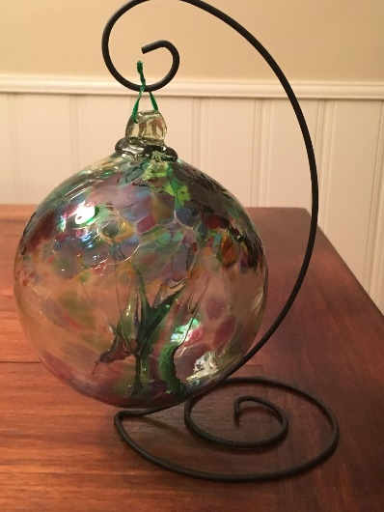
Glacier Point Solutions, Inc.
Quarterly All Hands Meeting – Holiday Meet & Greet
Sept 2018

Slide 2
Meeting Agenda
Team Member Changes
Close Rates
Average Survey Score
GPSI & Coach Accomplishments
Sales - Overcoming the Request to Talk to Some of Your Clients
Maintaining Coaching Frequency
Coaching Engagement Length
Helping clients see the value in Coaching

Slide 3
Meeting Agenda
Team Member Changes
Close Rates
Average Survey Score
GPSI & Coach Accomplishments
Sales Closing Skills – Katie B. Smith
Coaching Session Frequency for Individually Paid Clients
Client Retention
Helping the Client See the Value in Coaching
Client Closure Process
Reminder: Do not use company names in your marketing

Slide 4
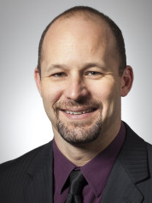
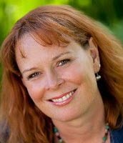
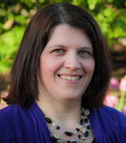
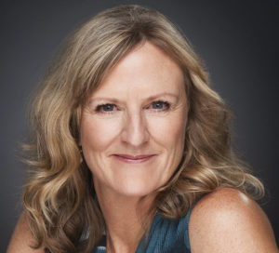

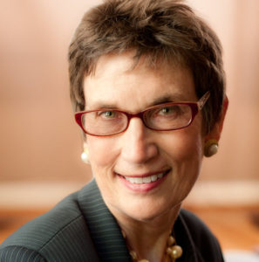
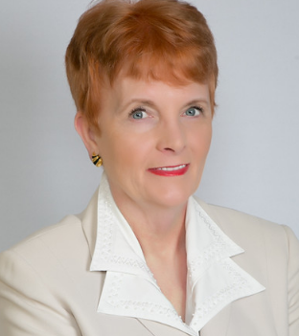
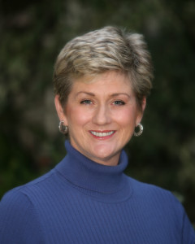


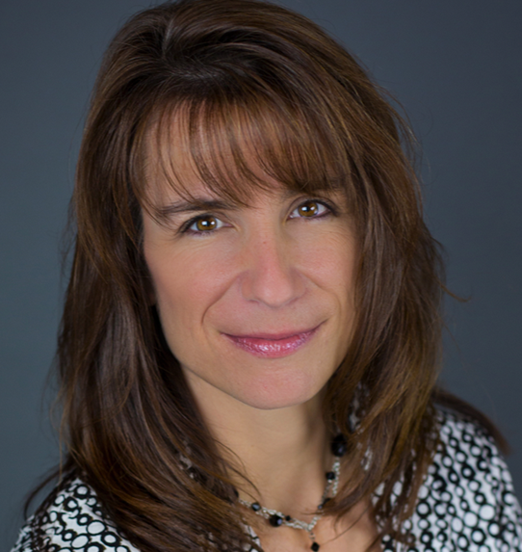
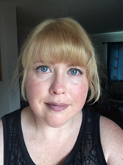
Glacier Point Solutions, Inc. - Team

Slide 5
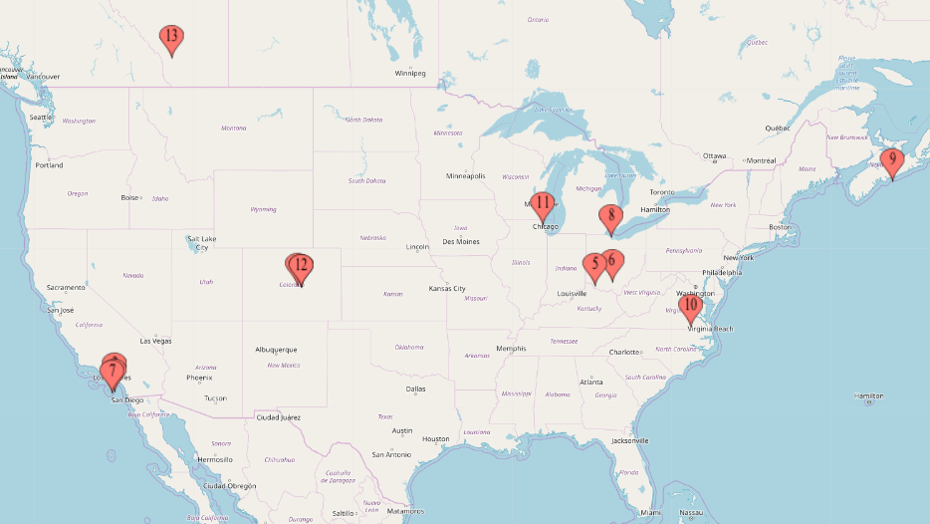
https://www.mapcustomizer.com/map/GPSI%20Coaches

Slide 6
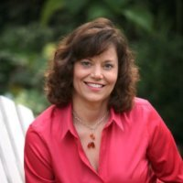
Heather Backstrom, Ed.D., CPCC, ACC
Heather Backstrom is going to discontinue doing Coaching for us.
Her business has grown and she doesn't have capacity for us anymore.
Good news for Heather!
Good luck!!!

Slide 7

New Coach
Welcome Plum Cluverius, PCC, MA/ABS
Training: Newfield Network
Met through David Couper
MA in Applied Behavior Studies
Consulting
OD Background
Healthcare, Government
Adjunct Professor: Federal Executive Institute
& University of Redmond
Richmond, Virginia

Slide 8

Our New Virtual Assistant – Angela Lindland
Lerae’s VA
VA since 2002
Calgary, Alberta, Canada

Slide 9
Close Rates – Individually Paying Clients
Jan-June: 48%
July-Sept: 46%
Oct-Nov: 64%
April-June: 56% (9 Opportunities)
So Far July-Sept: 100% (7 Opportunities – Ariana, Katie, Carole, & Jon)
  Your Hard Work in Increasing Your Closing Skills is Paying Off!!!
  Thank you!!!
  Goal Close Rate is 50%

Slide 10
Coaching Effectiveness Surveys - 2018
Corporate Clients: 4.9 out of 5
Overall: 4.79 out of 5
3.2 out of 5 is Satisfied
4.2 out of 5 is Very Satisfied
WOW!

Slide 11
Positive Comments About Glacier Point Solutions
“The Executive Coaching that Glacier Point Solutions delivers to myself and our organization is tremendously valuable. We are all delighted with your team and I am seeing meaningful leadership growth in our Executive Leadership Team members and Leadership Team members who are participating in the program. We plan to continue to grow and expand our Executive Coaching Program with Glacier Point Solutions.
We have seen demonstrative improvements in our targeted leaders’ leadership skills as a result of the Glacier Point Solutions coaching sessions (e.g., improved interpersonal conduct with their team members and peers; improved responsiveness to deadlines and commitments; improved attitudes towards team projects; better and more effective meetings; enhanced conflict management skills amongst peers and subordinates).
Glacier Point Solutions’ coaching methodology and delivery is personalized to individual’s needs with lots of flexibility, which has been key to further adoption within our leadership team and organization. Also, we have found the telephonic method of conducting the coaching sessions as an advantage of this coaching practice compared to others.” -- CEO, Publicly Traded (Nasdaq) Technology & Aerospace Company

Slide 12
Positive Comments About Glacier Point Solutions
“Thank you for having such great staff!” – C.N., Administrative Supervisor
“The resources Glacier Point Solutions provides are tremendous. I am using them in my staff meetings to increase the leadership skills of my leadership team.” – C.B., Vice President Operations, Banking Industry

Slide 13
Positive Comments About Coaches
“Katie helps me think outside the box. I now pay better attention to my surroundings and understand that people may not see things the way that I do. This approach has really helped our team become more established. Now, I am able to really get my point across. Thank you Katie!” --K.G., Supervisor, Public Utility
Katie: She coaches me holistically, intuitively tapping into what I need and going there. She takes great notes and links conversations easily together. She’s an excellent listener and supporter but also challenges me to do more. – Jeanne Schad, Vice President Business Development, Lee Hecht Harrison
Katie: “My Coach helps me think through situations. Role plays with me. Provides insightful comments and materials to help me in my coaching.”
Katie: “The most important thing about Coaching for me was learning how to deal with a heavy workload and still complete my tasks. I would often become overwhelmed with assignments and become discouraged in my work. Katie offered guidance and it was very beneficial. What most supported me about Coaching was being honest about who I am and the areas where I needed improvement. I can't see the outcome being any better than it is. Katie was on point!”

Slide 14
Positive Comments About Coaches
Katie is able to help me draw my own conclusions and insights during our monthly meetings. She is a fantastic listener and has excellent suggestions/observations. She creates a very supportive and trusting environment. I find it easy to open up with her.
Ariana: "When I began my coaching sessions, I had no idea what to expect. I have been in supervisory and management roles for many years and had never had the opportunity to work with a coach. So, I began with an open mind and an open heart. I was having some very trying challenges in my current position with my team and I was utilizing all of the tools in my toolbox from prior lives. My coach was supportive and she helped me to see situations from different perspectives. She provided me with additional tools that helped me to work through the obstacles. I will never be finished with my life learning plan but I feel as if having my coach expanded my ability to approach bumps in the road from new directions. Thank you Ariana for all of your guidance and support! I can only hope that others will take the opportunity to open themselves up to the possibilities of what having a coach can mean to them!“ – S.D., VP in Operations

Slide 15
Positive Comments About Coaches
“Sherri does a great job of engaging me in conversation about current challenges in my job. It’s great that she is also an ADHD coach and understands how I think and react to certain situations.” VP, IT
Matt: I will keep you guys in mind. Matt was very helpful and I would enjoy working with him again. – S.W., VP Operations
“Chris is a great listener, she is great at offering suggestions and/or solutions. She also does a great job of being supportive and empathetic to what you are experiencing.” M.M. VP, Finance

Slide 16
Coach Accomplishments
Ariana received her ACC!!!

Slide 17
GPSI Administrative Accomplishments
Continue to Improve SEO DonnaSchilder.com
  Improving Yelp Donna Schilder Listing – DS.com SEO
  Added a GPSI Yelp Listing – GPSI.com SEO
Improving LinkedIn presence
Re-writing DS.com Landing pages (Homepage complete)
Did first Vlog – Leadership
  Conquered Green Screen
Monthly Vlog or Blog – Leadership
  Feedburner
Implemented a new streamlined billing process
Selected and are training a new Virtual Assistant

Slide 18
2018 Glacier Point Solutions Projects
The Cannon Group
  6 2-Sesssion DiSC Debrief Engagements
LBS
  Continued to Coach 9 clients
AeroVironment - Mid-Cap Publicly Traded Aerospace Company
  Continued Coaching CEO & 6 Leaders (Added 3)
    4 Leadership – Debrief MBTI & DiSC - completed
    Possibly Other Leaders in the Future
Hilton Grand Vacations
  2 Leaders 3Q18
  Up to 6 2018
  Up to 10 2019

Slide 19
2018 Glacier Point Solutions Corporate/NonProfit Projects
The Cannon Group (WMWD)
  6 2-Sesssion DiSC Debrief Engagements
LBS
  Continued to Coach 9 clients
AeroVironment - Mid-Cap Publicly Traded Aerospace Company
  Continued Coaching CEO & 7 Leaders (Added 1)
Hilton Grand Vacations - New
  Possibly 2 Leaders 3Q18
  Up to 6 2018
  Up to 10 2019

Slide 20
2018 Prospects
Manufacturing Company – (Working to sell since early 2016)
  Talent Development Leader - Went to a new company
Large Nationwide Clothing Manufacturer – Target 1st- 3rd Qtr. 2019 (Working to sell since 1Q17)
  Multiple ELT Members – Ongoing

Slide 21
2018 Projects
9 New Individually Paying clients engaged
  3Q18 – 7 so far
  2Q18 - 9
  1Q18 – 14
  4Q17 - 8
  3Q17 – 13
  2Q17 – 17
Serving 37 Clients (Individual and Corporate)
Added 1 New Associate Coach

Slide 22
Sales Goal:
To Improve our Sales Close Rate
  Company Goal: Close 50% of Appropriate Clients
Katie B. Smith – Closing the Sale Tips

Slide 23
Sales Tip – Overcoming the “I Need to Talk to Some Of Your Clients” Objection
Ask questions to uncover the deeper reason they want to speak to references (fear, discomfort with the process, etc.) & Coach them
Offer a short complimentary Coaching session
Show them testimonials on LinkedIn & show them that they can look at the Profiles of the authors
Reassure them of your expertise
Tell them a story about a client that was like them that succeeded through Coaching
Have a client available for email questions or a phone call

Slide 24
Coaching Session Frequency
Increasing Individually Paying clients Session Frequency
  Goal – 3 Times a Month

Slide 25
Maintaining Coaching Session Frequency
Get their sessions completed early in the month
Coach them to find the time
Let them know the benefit of more frequent regular Coaching sessions
They do not need to complete Action Items between sessions
Coaching isn’t about Action Items, it’s about:
  Creating new neural pathways through conversation and discussion
  Looking for and engaging in new ways of thinking
  Focusing on priorities
  Seeing the big picture
  Having a sounding board
Coaching is the place to
  Keep a focus on Action Items & overcoming barriers to completing Action Items
Work is accomplished in the Coaching session itself

Slide 26
Coaching Engagement Length
Shorter than desired engagements, Goal: 6 Month to 1 year
Ethically, we shouldn’t try to keep clients in Coaching if they aren’t going to benefit or if they are ready to stop
But it is up to us to
  Support the client in attaining their goals
  Deepen their learning
  Guide them to do work they need to do to attain their goals
  Support the client in designing goals

Slide 27
Longer Engagements – Identifying Areas for Focus
Leverage Tools & Information from the DS.com to support their goals
Keep a List of Possible Topics​ - as they come up
Review the “Things to Work on with Your Coach” List(s)
  https://www.donnaschilder.com/things-to-work-on-with-your-leadership-coach/
  https://www.donnaschilder.com/things-to-work-on-with-your-career-coach/
  https://www.donnaschilder.com/things-to-work-on-with-your-job-search-coach/
  https://www.donnaschilder.com/things-to-work-on-with-your-life-coach/

Slide 28
Inventories, Assessments & Tools Available on DS.com
Leadership Client Page
  Things to Work on With Your Leadership / Executive Coach
  Two Assertiveness Quizzes
  The Thomas Kilmann Conflict Mode Instrument
  The Encouragement Index
  Leadership Development Questions
  VIA Inventory (they need to register, but it is free)
  The Power Perception Profile
  Who has used any of these?

Slide 29
Inventories, Assessments & Tools Available on DS.com
Life Improvement Client Page – Inventories & Tools
  Clean Sweep
  Wheel of Life
  Ability to Say No / Boundaries
  Time Management (e.g., Procrastination, Schedule)
  Gratitude
  Ideal Day
  Conflict Resolution
  Tolerations
  Assertiveness
  Happiness
  Joy

Slide 30
Creating Longer Engagements
In Your Group Discuss:
  Deepen their learning
  Guide them to do work they need to do to attain their goals
  Support the client in designing goals
  15 Minutes
    Signal when you are complete - Chat

Slide 31
Identifying Areas for Focus
Ask Questions to Uncover Topics
  What are you finding challenging?
  Where do you feel tense in your day?
  What do you want that you don’t have?
Offer options for the Coaching session focus
  Tools and/or Assessments (See Next Slide)
  A Topic You Think Might Help Them
Periodically: Review
  Who the client is
  What they want
  Identify Coaching tools and topics that would support them

Slide 32
Life Coaching (for All Clients) –
Personal Development Topics
Physical Health
  Diet
  Exercise
  Nutrition
  Sleep
Mental Health
  Stress Reduction
  Spirituality
  Anxiety Reduction
  Reducing Fear
  Reducing Procrastination

Slide 33
Life Coaching – Personal Development Topics
Friendships
Family
Personal Goals – DS.com
Work/Life Balance

Slide 34
Coaching Modalities
Modalities | Modalities
Guided Imagery | Mind-Body
Affirmations | Appreciative Inquiry
Box Thinking | Head – Heart – Gut
Inner Child Work | Brainstorming
Seeking Feedback | Force Field Analysis
Drawing | NLP
Image Work | EFT
Assessments | Strengths
Internal Voices | Visioning / Imagineering

Slide 35
Helping The Client See the Value in Coaching
Go Deep
Questions to Help Them See The Value
  What value did you receive from today?
  What value are you getting from Coaching?
  How is your work changing?
  How is your life changing?
  How have you changed?
  How have you grown through Coaching?
Any other ways?

Slide 36
Glacier Point Solutions, Inc. Coaching – Services Offered
Executive Coaching
Career Coaching
Job Search Coaching
Small Business Coaching
Sales Coaching
Life Coaching

Slide 37
Summary
Sales - Overcoming the Request to Talk to Some of Your Clients
Maintaining Coaching Frequency
Coaching Engagement Length
Helping clients see the value in Coaching

Slide 38
Glacier Point Solutions, Inc. - Executive Coaching
Our mission is to help our corporate and non-profit clients create a culture that’s inspiring and innovative, and leaders who are encouraging, assertive, and effective.
We support companies in offering Leadership Coaching Programs that are more impactful than Coaching one Leader at a time and offer ongoing support to leaders as needed.

Slide 39
From Glacier Point Solutions, Inc.:
Thank You!!!!!
For all your hard work.
  I’m so glad you are part of our team!

