Slide 1
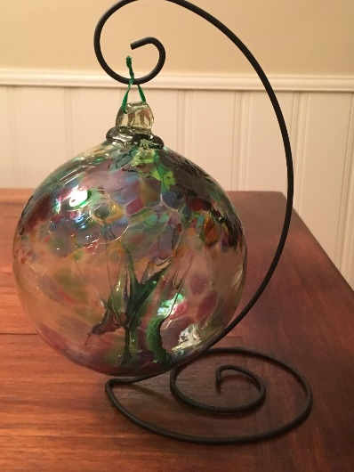
Glacier Point Solutions, Inc.
Quarterly All Hands Meeting – Holiday Meet & Greet
June 2018

Slide 2
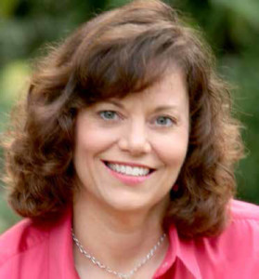
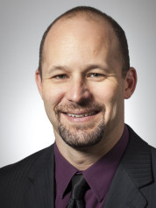


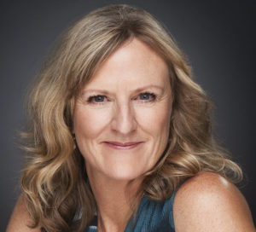

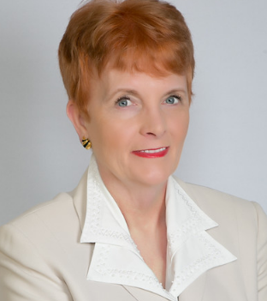
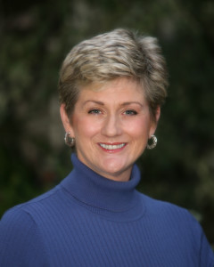


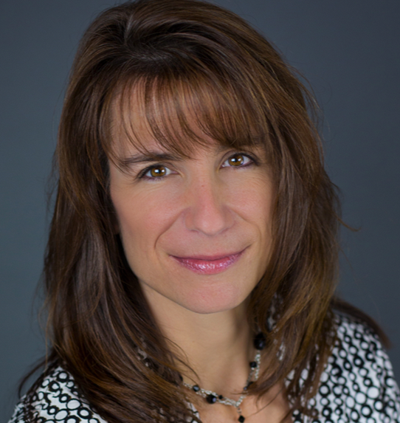
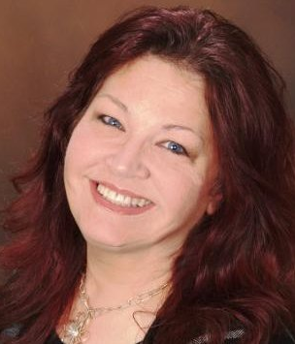
Glacier Point Solutions, Inc. - Team

Slide 3
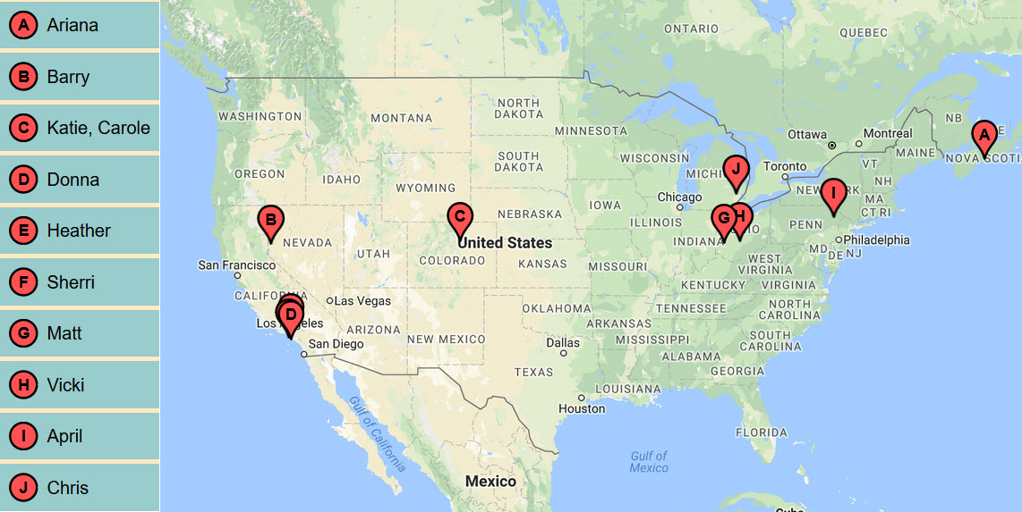

Slide 4
Meeting Agenda
Lerae Gidyck: “Coaching Thru The Self Deception that Blinds Our Clients“ (“Box Thinking”) -
  Collusion and Q&A Session – 30 Minutes
Glacier Point Solutions, Inc. Business Overview
Donna Schilder: My Interpretation of the “Box Thinking” Tools
  “Out of the Box” Thinking
  Comparing “In the Box” & “Out of the Box” Thinking
  Questions to Explore “In The Box” and “Out of the Box”
  Overview Of the Process of – Getting Into & Out of The Box
  "Boxes I Carry" Intervention Steps
  Coaching Demonstration

Slide 5
Close Rates – Individually Paying Clients
Jan-June: 48%*
July-Sept: 46%*
Oct-Nov: 64%*
1Q18: 71%*
We increased our Close Rate by another 7% over 4Q17!!! Great job!!!
Your Hard Work Continues to Pay Off!!!
*Of appropriate potential clients

Slide 6
Sales Goal:
To Improve our Sales Close Rate
  Company Goal: Close 90% of Appropriate Clients
  Associate Coach Goal:
    Close 50% of Clients with 2 Consults
    Close 90% of Clients with 1 Consult

Slide 7
Positive Comments from Clients
2018 Average Coaching Effectiveness Survey Score: 4.5 (4.5 Corporate)
Vicki: "Vicki was a consummate professional and very insightful-- I enjoyed speaking with her and got some excellent tips."
Katie: ”My client’s boss is complimenting him all the time – he has done a great job handling some employee conflict and is using strategies he created in our calls.”
Katie: “My CEO and my colleagues have commented that they can see the improvements in my leadership and communication skills.”
Ariana: “Interview preparation with Ariana was very helpful. It helped me see where I need to practice and what I need to focus on.”
HR Director: “We just love your Coaches. I know all of them are very good.”

Slide 8
Coach Accomplishments
Ariana has 3 clients that meet with her 3 times a month
Charissa, Jon, and Jeannie have all had their first clients with us

Slide 9
GPSI Administrative Accomplishments
Google placement for DonnaSchilder.com dropped. It happened to a lot of people (AI). Corrective Actions:
  Hired an SEO Consultant & Working on SEO Strategy
  Continue to improve Yelp Listing
    Which improves DS.com SEO
    Is bringing us clients
  Add a Glacier Point Solutions – Yelp Listing
Passed 5,000 Connections on LinkedIn
Joined a LinkedIn Post - Boost Group (Boosting views of Posts)
  All members 5,000 Connections
  So far 1100 views on one Post linked to a Blog
Working on Rebranding Strategy
Please follow us on Twitter: @LeadtoEnergize

Slide 10
2018 Glacier Point Solutions Projects
New Water District
  6 DiSC Debriefs 2Q18
  Potentially: 11 More DiSC Debriefs 3-4Q18
LBS
  Continued to Coach 9 clients
Mid-Cap Publicly Traded Aerospace Company
  Continued Coaching CEO & 7 Leaders (Added 1)
    Additional: 4 Leadership – Debrief MBTI & DiSC
      1 Wants to Continue Coaching – Waiting 3 Months

Slide 11
2018 Prospects
Manufacturing Company – Working to sell to them since early 2016
  Phone Meeting in March 2018
  7 Client Coaching Project (ongoing, rotating leaders)
Large Nationwide Clothing Manufacturer – Target 3rd & 4th Qtr.
  Multiple ELT Members – Ongoing
  One Leader Opted to Start Coaching & Pay for it Themselves Prior to Program Being Implemented
One Leadership Client started for a Global High Tech firm (Subcontracted)

Slide 12
2018 Projects
13 New Individually Paying clients engaged in 1Q-2Q18 the Compared to 9 the 3Q-4Q18
  Increased Close Rate – Congratulations!
Serving 52 Clients (Individual and Corporate) Up from 35
Successfully Onboarded 3 New Associate Coaches
Vetting One More Associate Coach for 3Q18
Strategic Partners – In-Person Training & Facilitation
  Sherri Cannon – Did 5 Dysfunctions of a Team & Fierce Conversations

Slide 13
Reminders
Let us know when clients end their engagement with us
Invoices
  Add dates of Coaching sessions to invoices.
  Please label your time reviewing Assessments & Inventories as “Analysis Time”
  Send them to April and I

Slide 14
Donna Schilder: My Interpretation of the “Box Thinking” Tools
“Out of the Box” Thinking
Comparing “In the Box” & “Out of the Box” Thinking
Questions to Explore “In The Box” and “Out of the Box”
Overview Of the Process of:
  Going Into the Box
  Communicating from the Box
"Boxes I Carry" Intervention Steps
Coaching Demonstration

Slide 15
What Is Box Thinking
“Box Thinking” is a habit of thinking that our clients acquired long ago.
It is a protective mechanism that is triggered when a person experiences uncomfortable or painful emotions. It worked for them when they first used it
“Box Thinking” is extreme thinking. The mind extrapolates from one or a few negative situations to seeing the whole world in a negative way. This somehow feels safer or protective to the person

Slide 16
How Does Knowing About Box Thinking Help?
Once a client knows about their “Box Thinking”, they can choose to either continue to see things from the Inside “The Box” or choose to see things from Outside “The Box”
Awareness of the Box and getting out of the box, gives the person freedom:
  “I choose what relationship I will have with the person or situation.”
  I choose how I will be in relation to this person.

Slide 17
Glacier Point Solutions, Inc. Coaching – Services Offered
Executive Coaching
Career Coaching
Job Search Coaching
Sales Coaching
Small Business Coaching
Life Coaching
Mentor Coaching

Slide 18
Glacier Point Solutions, Inc. - Executive Coaching
Our mission is to help our corporate and non-profit clients create a culture that’s inspiring and innovative, and leaders who are encouraging, assertive, and effective.
We support companies in offering Leadership Coaching Programs that are more impactful than Coaching one Leader at a time and offer ongoing support to leaders as needed.

Slide 19
From Glacier Point Solutions, Inc.:
Thank You!!!!!
For all your hard work.
And, for committing your time to developing your Coaching & Sales skills.
  I’m so glad you are all part of our team!

