Slide 1
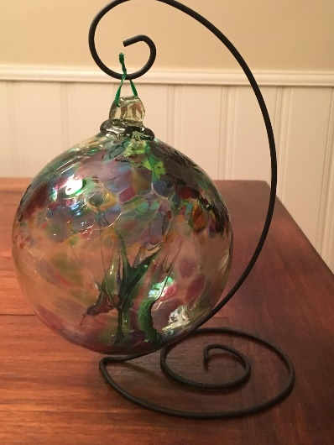
Glacier Point Solutions, Inc.
Quarterly All Hands Meeting
Sales Skill Development - 3
September 2017

Slide 2
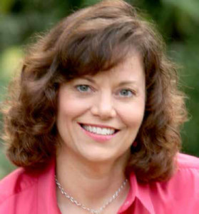
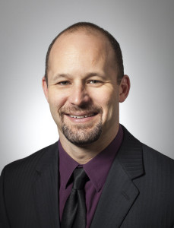
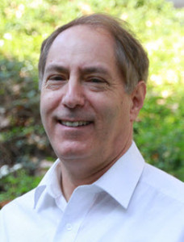
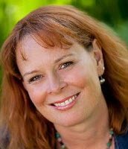
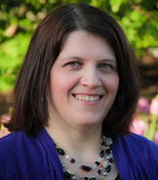
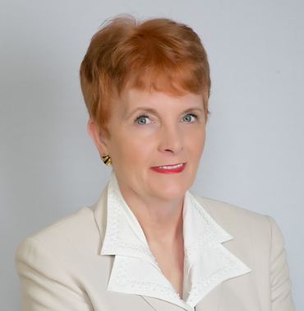
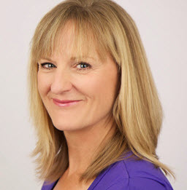
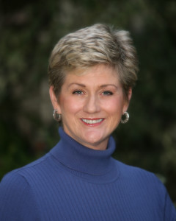

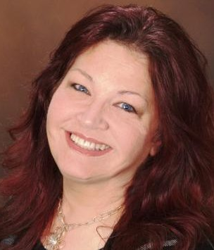
Glacier Point Solutions, Inc. - Team

Slide 3
Meeting Agenda
Celebrate Accomplishments
Current Glacier Point Solutions, Inc. - Projects
Glacier Point Solutions Ideal Associate Coach Characteristics
Sales Workshop: Closing the Sale
Keeping the Client Engaged & Helping Them See the Value

Slide 4

Vicki Rich, ACC
Vicki attained her ACC!!!!!

Slide 5
GPSI Administrative Accomplishments
Continued improving the DonnaSchilder.com website
Improved my LinkedIn Background
Added a new Sales Consultation recording to the GPSI Associate Coach webpages
Implemented Close Rate Tracking for Individually Paying Clients – (Ariana and I worked on this)
Please follow us on Twitter: @LeadtoEnergize

Slide 6
Positive Comments from Clients
“Ariana is a great guide for participating in the Coaching process. We are building a strong relationship and she is helping me make the most of Coaching. I am able to see how I already flex into different styles in different situation and capitalize on this more with my vendors, staff and colleagues.”
“I like the simple tools and short articles Barry shares with me. I like that I can pick tools and concepts up quickly and apply them to my work immediately. I loved the DiSC Assessment. It has really helped me stretch into different styles”

Slide 7
Positive Comments From Clients
“Thank you for your support and encouragement today! You have been, and continue to be a great support to me.” “Katie is a terrific career coach who is engaging and helpful. She listens closely and also gets to the point to ensure your time together is effective. I enjoyed my conversations with her and always took away specific action items that were right for me. I highly recommend working with Katie to get really targeted in finding a job you’ll love.”
“I adore you and your team, I found your support and coaching to be fantastic and feel much better equipped to handle many things than before our coaching began. Our leaders are LOVING coaching also.” (Kudos to Heather, Matt, and Chris)

Slide 8
2017 Glacier Point Solutions Projects
I decided to narrow our focus and discontinue offering In-Person training through GPSI
  We now have a strategic partnership with Sherri Cannon and Sharon Rich for Training & Team Building
  We may add another DiSC Trainer(s) as strategic partners
SCWD
  Completed
LBS
  Continued to Coach 9 clients and did some DiSC Assessments
Staffing Firm
  1 clients
  May be re-engaged for a previous client next year
  Doing DiSC Comparison Sessions with CEO/President & a Key Leader
Mid-Cap Publicly Traded Aerospace Company
  Continued Coaching CEO & 2 Leaders and Added 1 Leader (3)
    Will add one this month and may add 2 more in a few months
    Met with HR Manager in June and am building relationship

Slide 9
2017 Projects
Manufacturing Company – Working to sell to them since early 2016
  7 Client Coaching Project (ongoing, rotating leaders)
  Coaches will do Phone Calls to Meet Talent Director & Talent Management VP – Starting in November
    I will do an intro in the call with your Coaching credentials
    Be professional
    Share your Coaching philosophy
    Emphasize your business experience and your personal leadership experience
    Emphasize your Coaching experience with Manufacturing and each departmental function (HR, Finance, Sales, Marketing, Engineering)

Slide 10
2017 Projects
Continued with a Client at a Large Credit Union
  Still working to build more clients here
9 New Individually Paying clients engaged in the 3rd Qtr Compared to 5 the 2nd Quarter, 6 the 1st Qtr
  Increased Close Rate – Congratulations!
Serving 45 Clients (Individual and Corporate)
  Additional DiSC Assessments
  32 Are Women
Recruiting new Coaches starting 10/17 (Career/Job Search, Leadership, Sales, Life, Male) – Have 7 Candidates to Review

Slide 11
Sales Workshop Goal:
To Improve our Sales Close Rate
  Company Goal: Close 90% of Appropriate Clients
  Associate Coach Goal:
    Close 50% of Clients with 2 Consults
    Close 90% of Clients with 1 Consult

Slide 12
Close Rates – Individually Paying Clients
Jan-June: 49%
May-June: 100%
July: 100%
Overall Close Rate Jan-July: 58%
May implement Corporate Paid Clients Close Rates Later

Slide 13
Our Ideal Client – ICF Global Study
(Most Common Characteristics of Coaching Clients)
U.S.
Canada, UK, Australia
Female
46-55 (U.S.)
36-45 (Canada, Australia, U.K.)
Bachelor’s or Master’s
Coaching Topics – U.S.
  Business Management - 16% (I think this matches our Leadership)
  Career Opportunities (Matches our Career Exploration and Job Search) – 15%
  Self Confidence – 11%
  Work/Life Balance – 11%
  Work Performance – 7%
  (Not Time Management?????)

Slide 14
Coach’s Sales Process
Build Rapport
Build Credibility - Review
Identify the Pain / Issue / Goal
Provide Solutions – Coaching, Coaching with You
Overcome Sales Objections
Appeal to Motives
Gain Commitment
Close the Sale

Slide 15
Coach’s Sales Process
Build Rapport
Build Credibility - Review
Identify the Pain / Issue / Goal
Provide Solutions – Coaching, Coaching with You
Overcome Sales Objections
Appeal to Motives
Gain Commitment
Close the Sale

Slide 16
“Closing the Sale” Mindset
– (4 Coaches Said This was Their Challenge)
Set the intention at the outset that you will get the client
Visualize the client saying yes
Begin with the end in mind
Know that Coaching works
Know that you are a skilled Coach
Know that you can help the client
Any other techniques for managing the mindset?

Slide 17
Close the Sale
Ask a Closing Question
Ramping up to the Closing Question:
  Use their Motivation(s) As a Lever
  Recap the Benefits
  Get them Saying “Yes”
  Trial Close
  The Assumptive Close
  Miscellaneous Close Techniques

Slide 18
Ask a Closing Question
Are you ready to schedule your first session?
  You’re not required to meet with anyone else if this feels like a fit.
When would you like to meet for our first session?
I’m available May 6 at 2, May 7 at 9 AM, and May 8 at 4 PM. Which of these would work for you for our first session?
We just need CC information to initiate the engagement, can our Assistant April Contact you for that?
I know that you’re going to find Coaching helpful, can we start next week?

Slide 19
Use their Motivation as a Lever to Close the Sale
So, you’ve identified that you aren’t as good at asking for what you’re worth as you’d like to be
  What would asking for what you’re worth look like?
  You’d be confident, smooth, own your worth
  Tell me why you want this.
  Are you ready to get started? I’m available on Monday at 8 AM.
How much is it worth to you to attain your goals?
How would it feel to do X?
How would your life change if you were to accomplish x?
Would it look like, feel like, sound like if you attained your goals?
How would it feel to have X?
How much time and money is it worth to achieve your goals?

Slide 20
Recap Benefits of Coaching
So, Coaching will create accountability for you, give you a place to create a plan, help you explore what holds you back, give you a place to practice.
  Are you ready to get started next week? I’m available x, y, and z.
Connect the dots:
  If you start working on your resume now, you will be able to start sending resumes out June 19, and you could have interviews by July 30th
  If your networking skills were stronger, do you think you’d be getting more leads at Networking Meetings? How would that impact your business?

Slide 21
Get them Saying “Yes”
Does Coaching seem like it would be valuable?
Do you think Coaching would help you reach your goals?
Was the Laser Coaching session helpful?
It seems like we are a good fit, do you agree?
Would you like my help?

Slide 22
Trial Close (Dale Carnegie Sales Advantage)
Ask the client a benefits question that would yield a positive answer
  How do you think Coaching could help you do x?
    Are you ready to engage me as your Coach?
  How do you think Coaching would help you create accountability for yourself?
Are you ready to move forward?
If we get started today, you should have your resume done by x. Can we start on next Tuesday?

Slide 23
The Assumptive Close
When should we get started?
What date do you want to start?
Other Examples?

Slide 24
Miscellaneous Closes
Why don’t you give Coaching a try?
Tell me your thoughts.
In your opinion, does what I’ve outlined solve your challenge?
Is there any reason we can’t get started next week?
Can we calculate what the impact of Coaching is worth to you?
Tell the story of a client success.
Watch for the client to close the sale

Slide 25
Close the Sale – Two Coaches
How to handle it when more than one Coach is doing a consultation with the client
  We are all great Coaches, but if you’re ready to work with me, you’re not required to have a meeting with the other Coach
  Can we schedule a time for me to contact you after your other consultation to get your thoughts?
  I would love to work with you. Let me know your thoughts after the other consultation.

Slide 26
Coach’s Sales Process
Build Rapport
Build Credibility
Identify the Pain / Issue / Goal
Provide Solutions
Overcome Sales Objections
Appeal to Motives
Gain Commitment
Close the Sale

Slide 27
Helping The Client See the Value in Coaching
Go Deep
Questions to Help Them See The Value
  What value did you receive from today?
  What value are you getting from Coaching?
  How is your work changing?
  How is your life changing?
  How have you changed?
  How have you grown through Coaching?
Any other ways?

Slide 28
Keeping the Client Engaged – If it Feels Like They’re Running Out of Areas of Focus
Ethically, we shouldn’t try to keep clients in Coaching if they aren’t going to benefit or if they are ready to stop
Reviewing the “List of Things to Work on With Your Coach”
Leverage Tools & Information from the DonnaSchilder.com website
Ask Questions to Uncover a Topic
  What are you finding challenging?
  Where do you feel tense in your day?
  What do you want that you don’t have?
Any Other Ways?

Slide 29
Helping the Client Identify Topics for Focus
Offer options for the Coaching session focus
  Tools (Clean Sweep, Wheel of Life, Ability to Say No, Gratitude, Ideal Day, Conflict Resolution, DiSC, Assertiveness Inventory, Tolerations, VIA Strengths or Strengths Finder)
  A Topic You Think Might Help Them
Keep a List of Possible Topics for the Future As You Work with the Client​
At the Beginning of the Engagement and Periodically: Review who the client is, what they want, and identify Coaching tools and topics that would support them

Slide 30
Glacier Point Solutions, Inc. Coaching – Services Offered
Executive Coaching
Career Coaching
Job Search Coaching
Small Business Coaching
Sales Coaching
Life Coaching
Mentor Coaching

Slide 31
Glacier Point Solutions, Inc. - Executive Coaching
Our mission is to help our corporate and non-profit clients create a culture that’s inspiring and innovative, and leaders who are encouraging, assertive, and effective.
We support companies in offering Leadership Coaching Programs that are more impactful than Coaching one Leader at a time and offer ongoing support to leaders as needed.

Slide 32
From Glacier Point Solutions, Inc.:
Thank You!!!!!
For all your hard work.
And, for committing your time to developing your Coaching & Sales skills.
  I’m so glad you are all part of our team!

