Slide 1
Glacier Point Solutions, Inc.
Quarterly All Hands Meeting
Sales Skills Development
March 2017

Slide 2
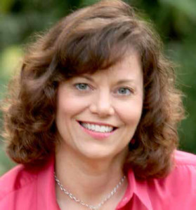
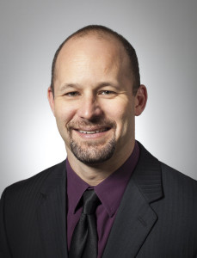
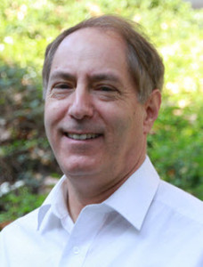
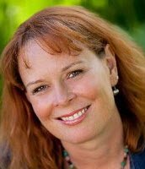
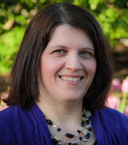
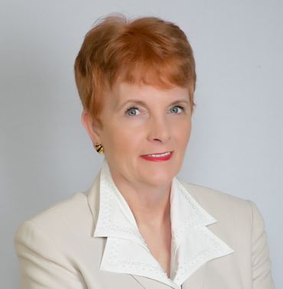
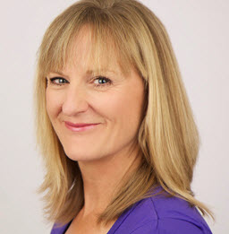
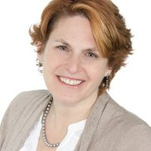
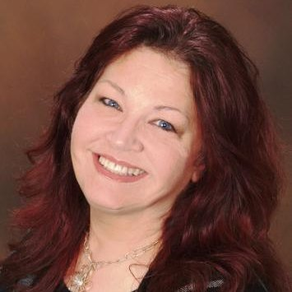
Glacier Point Solutions, Inc. - Team

Slide 3
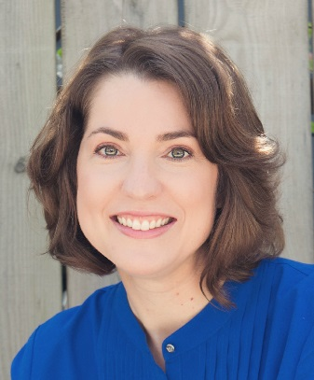
Meeting Agenda
Celebrate Accomplishments
Current Glacier Point Solutions, Inc. - Projects
Sales Process Overview
Overcoming Sales Objections – Ariana Elsie McNally
Building Rapport & Credibility

Slide 4

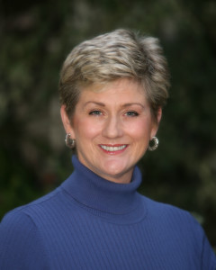
Sherri Cannon, PCC
Attained her PCC!!!!!!

Slide 5
2017 Glacier Point Solutions Projects
SCWD
  Did Virtual DiSC Team Building for 1 additional department
  Coaching 1 new client
  Sherri Cannon:
    “5 Dysfunctions of a Team” – April, 2017
LBS
  Continue to Coach 8 clients (will add 1 this month)
Staffing Firm
  Completed CEO DiSC Debrief
  Started Coaching 2 new clients (1 year engagement)
  May be re-engaged for a previous client in May
Mid-Cap ($200 Million) Publicly Traded Aerospace Company
  Started Coaching the CEO
    4-5 New Clients – Possibly starting in April

Slide 6
2017 Projects
Small Law Practice – Started in March
  2 Coaching Clients
  Monthly Group Coaching
  360 Degree Assessment
Manufacturing Company - Meeting with Talent Director, rescheduled for April 2017
  7 Client Coaching Project (would probably be an ongoing program)
HR Director from SCWD moved to a new Water District
  Possibly 1 Coaching Client
  Provided Training Proposal – Being Presented to CEO
6 New Individually Paying clients engaged since December

Slide 7
Sales Workshop Goal:
To Improve our Sales Close Rate

Slide 8
Sales Skills Development Suggestions
Encourage all of you to:
  Listen: Sales Call/Consultation Recording (on the GPSI site)
  Read the Sales Advantage – Dale Carnegie or other Sales Book
  Take a Sales Training course
    Skillpath Closing the Sale
    Skillpath – Strategic Selling Skills
    National Training Seminars
    Fred Pryor
    College Extension
    Community Workshops
    Small Business Association
    SCORE
    Dale Carnegie
  Work with your Coach on Sales Skills and Barriers to Sales

Slide 9
Glacier Point Solutions – Main Sources of Sales Leads
Websites (DonnaSchilder.com and GlacierPointSolutions.com)
LinkedIn
Referrals from Past & Existing Clients
Referrals from Other Coaches
Referrals from Centers of Influence
Our Coaches – Upsell / Referral
Networking
Podcast and Internet Radio Interviews
Internet Listings (ICF, PIHRA, Yelp, Google Business, etc.)

Slide 10
Sales Process
Corporate Paid | Individually Paid
Lead Comes In – Phone Call, LinkedIn Email, Email | Lead Comes In – E-Calendar, Phone Call, Email
Consultation With Potential Client Company | Donna or Ariana do a Consultation With Them
Send Corporate Marketing Material | Explain Services
Write Proposal W/ Suggested Coaches | Explain Prices
Do A Follow Up Sales Call & Adjust Proposal | Offer Coach(es)
Client Signs Letter of Agreement | Set Up Consultation(s) On Coach Calendar or Thru Email
Offer Coach(es) to Client(s) | Coach(es) Do Consultation(s) with Client
Coach(es) Do Consultation W/ Client | Follow Up After Consultation(s)
Client Selects Coach | If yes, initiate On-Boarding Process
If not CEO or Owner, Work w/ Boss to Create Coaching Objectives
Initiate On-Boarding Process

Slide 11
OnBoarding Process
If engaged:
  Individually Paid – April Obtains Credit Card
  April sends Welcome Document
  April sends DocuSign Coaching Agreement
    Coach Signs DocuSign Coaching Agreement
    Client Signs DocuSign Coaching Agreement
  Coach schedules first Coaching session with Client (if not already done)
  Coach sends Personal Information Sheet to April for the database
  Surveys sent at 3 mos., 6 mos., then 1 year, then every 6 months

Slide 12
Sales Process
Build Rapport
  Build Credibility
Identify the Pain / Issue / Goal
Provide Solutions
Overcome Sales Objections
Appeal to Motives
Gain Commitment
Close the Sale

Slide 13
Overcome Sales Objectives
Ariana Elsie McNally –
  Former Sales Manager & Sales Trainer for Xerox Canada

Slide 14
Sales Process
Build Rapport
  Build Credibility
Identify the Pain / Issue / Goal
Provide Solutions
Overcome Sales Objections
Appeal to Motives
Gain Commitment
Close the Sale

Slide 15
Build Rapport
Listen Deeply
Acknowledge & Compliment Them
Make them Feel Important
Show that You Care
Find & Identify Things In Common
Let Them Know You Have Personal Experience with their Pain/ Issue / Goal

Slide 16
Find Things In Common & Share
Review LinkedIn Profile If Possible Prior to the Call
  Connections
  University
  Companies
  Job Type
  Industry
At the Beginning of the Conversation
  Brief Comments about Things they Share

Slide 17
Let Them Know You Have Personal Experience with their Pain/ Issue / Goal
I worked in a male dominated industry for years as well (Aerospace). It was hard, but was able to find a way to excel.
There was a VP at the company, that when first introduced to me asked if I was a secretary (which wasn’t the case).
Then, when my boss went to send me on a business trip, he said, we don’t send women on business trips.
5 years later, when I went to leave the company, he called in from sick leave for treatment for cancer and said, “offer Donna any management position she wants. We can’t keep losing our best talent.”
  I overcame the situation by: studying how the men interacted and finding things I could do naturally that were similar, getting a male mentor who could help me understand the behaviors and politics, and asking for time with the VP to present ideas and how the business could be improved.
I know that Coaching can help you make similar shifts that will increase your ability to succeed in a male dominated industry.

Slide 18
Let Them Know You Have Personal Experience with their Pain/ Issue / Goal
I used to get very nervous doing presentations as well, but I overcame it. My hands would shake and I would loose my place.
I worked with my Coach over the years to overcome it.
My Coach supported me in delving deep into what was causing my nervousness. One cause was a teacher who told me I wasn’t a good public speaker. Another thing that was holding me back was that I was made fun of once when I was doing a book report in school.
My Coach helped me identify these issues, and the beliefs that went with them and replace them with positive beliefs in myself. We also came up with some breathing techniques and other strategies that helped. Today I rarely get nervous. I know Coaching will help you do the same.

Slide 19
Let Them Know You Have Personal Experience with their Pain/ Issue / Goal
You’ve:
  Experienced the same challenge
    Overcome a similar obstacle
    You’ve worked with your Coach on a similar situation
  Done their job
  Done a related job
  Worked in their industry or a related industry
  Studied something in school that relates
  Done a similar thing for an association or charity
  Helped a client overcome the same challenge
  A family member has done the same job

Slide 20
Quarterly All Hands Meetings – Future Topics
Sales Skills Part 2
Review of Donna Schilder.com Resources:
  Leadership
  Life Improvement / Happiness Resources
  Personal Goal Setting Process - E-Book
Glacier Point Solutions, Inc. Branding & Processes

Slide 21
Glacier Point Solutions, Inc. Coaching – Services Offered
Executive Coaching
Career Coaching
Job Search Coaching
Small Business Coaching
Sales Coaching
Life Coaching
Mentor Coaching
Training

Slide 22
Glacier Point Solutions, Inc. Executive Coaching
Our mission is to help our corporate and non-profit clients create a culture that’s inspiring and innovative, and leaders who are encouraging, assertive, and effective.
We support companies in offering Leadership Coaching Programs that are more impactful than Coaching one Leader at a time and offer ongoing support to leaders as needed.

Slide 23
Benefits to Engaging Glacier Point Solutions, Inc.
One-stop shop providing multiple Leadership/Executive Coaches
  Creates simplicity for the organization
  Creates trust for coached leaders
  Creates ability to match Coach to Leader’s needs and style
Experienced, proven Coaches
Coaches have Leadership experience with Corporations and Non-Profits

Slide 24
From Glacier Point Solutions, Inc.:
Thank You!!!!!
For all your hard work.
And, for committing time to developing your Coaching & Sales skills.
  I’m so glad you are all part of the team!

