Slide 1
Interview Preparation
Ariana Elsie McNally
&
Katie B. Smith

Slide 2
Agenda
Welcome
Interview Preparation
  Mindset
  Preparation & STAR
  Interview Objectives
Interview Practice
  Mock Interview
  Different types of Interviews
  Questions to Ask & Closing the Interview
  Follow-up
Q&A
  Coaches share one interviewing tip
  Take-away

Slide 3
Welcome & Introductions
Ariana Elsie McNally
Career, Executive, Sales & Business Coach, ACC in progress
2.5 years – Coach U - ACCP in progress
Something you don’t know about me is…
Katie B. Smith
Executive & Career Coach, PCC
8 years – Coach U Grad
Something you don’t know about me is…..

Slide 4

Welcome
Happy New Year!
  Share ONE WORD that describes your Holiday
  OR
  Share your WORD that describes your intention for 2017
Notes:
Highlight ONE WORD that describes your Holiday or ONE WORD that describes your intention/how you want to BE in 2017.

Slide 5
Interview Preparation - Mindset
Think like an Entrepreneur or Consultant – Who & Where needs your skills?
  Entrepreneurs look for opportunities and are proactive.
  The company has a problem…What IS the problem?
    How can you show that you can solve that problem?
    How will you convey your value? What skills & experiences will help solve this problem?
  Identify creative ideas to bring to the interview: 30-60-90 day plan, questions that dive deeper, etc.
Notes:
DonnaSchilder.com – Manage the Mental Game of Job Search: https://www.donnaschilder.com/manage-the-mental-game-of-your-job-search/
Entrepreneurial mindset – this mindset is helpful in the overall Job Search. It helps to create a feeling of empowerment. And leads to being proactive. It puts the Job Searcher into the mindset that their skills & experiences have value and they have a choice as to where they want to put their skills to use. It’s also helpful to get into a mindset to initiate Information Interviews.

Slide 6
Interview Preparation - Mindset
Asking questions that are curious, direct and clear are key to finding out what their needs are and the skills they need to hire.
Speak with confidence and trust by listening to your intuition for what to say next.
Prepare in body and mind - Amy Cuddy Ted Talk.
Video tape yourself answering interview questions.
Notes:
TIP: watch Amy Cuddy talk, then video yourself conducting a mock interview (Could have a friend asking them question or ZOOM with the coach and being recorded)
(Amy is a social psychologist, author and Lecturer. Cuddy has spoken about the psychology of power, influence, nonverbal communication, and prejudice.)
Link to TED Talk: https://www.ted.com/talks/amy_cuddy_your_body_language_shapes_who_you_are

Slide 7
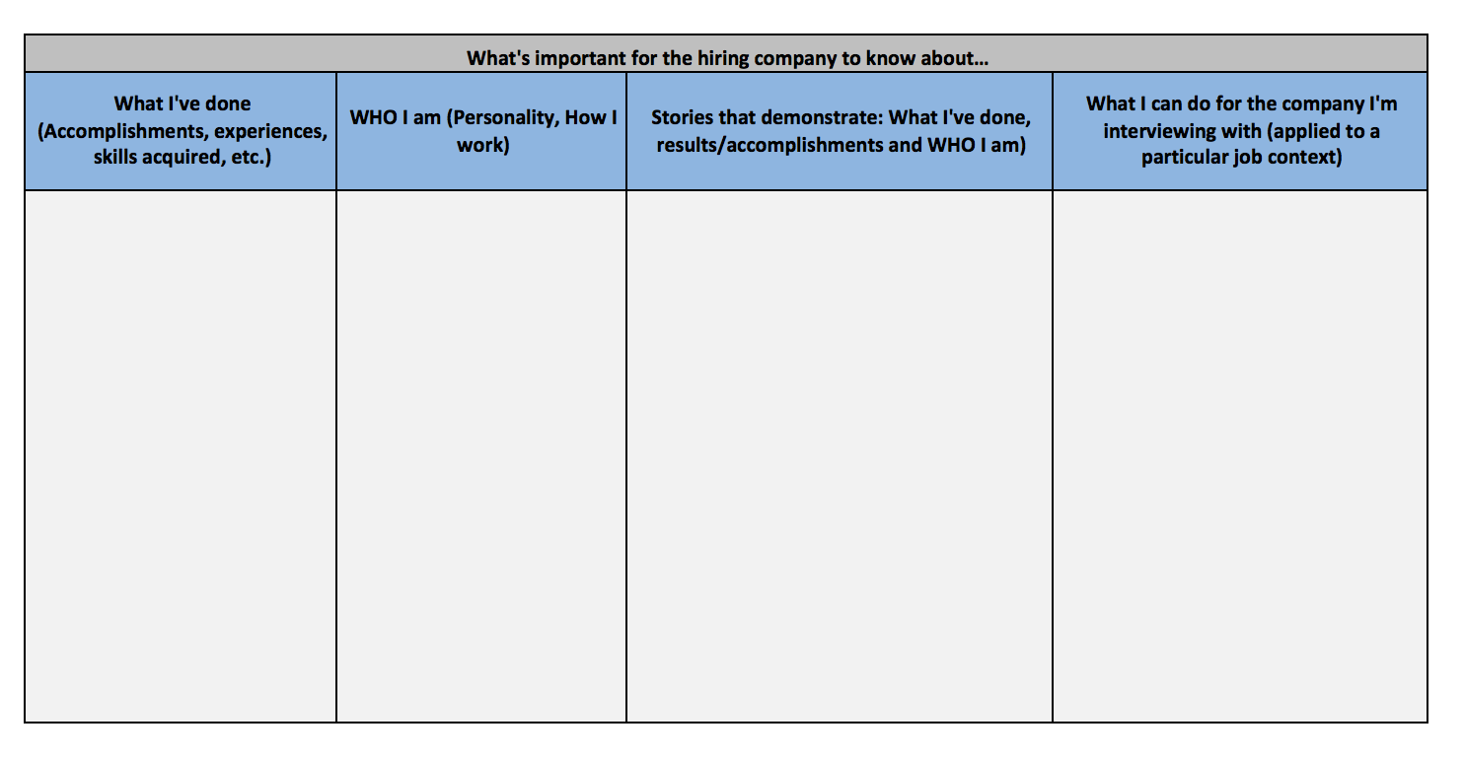
Interview Preparation
Notes:
These questions will help prepare for an interview. Show worksheet.
Worksheet is great to discuss in a coaching session or can be done as pre-work.
Worksheet is useful particularly if the Job Searcher has been out of Job Search for some time. (It’s been a long time since they’ve had to interview for a position)

Slide 8
Preparation & STAR
Recognize when to use STAR
  “Tell me about a time when….”
  “How would you react or how did you deal with a situation where…”
  “Describe a time when…”
S – Situation
T – Task
A – Action
R - Results
Notes:
S’ for Situation: Start your answer by providing the background of your experience. Describe the circumstances of your involvement. Provide enough detail to preface the rest of your narration.
‘T’ for Task: Describe the challenge at hand and what needed to be done. Give the expected outcome and any conditions that needed to be satisfied.
‘A’ for Action: Elaborate your specific action in response to the challenge. Specify analytical work, team effort or project coordination. Use ‘I’ and ‘we’ statements as appropriate.
‘R’ for Results: Explain the results of your efforts: what you accomplished, what you learned, how your managers and team responded, and how your organization recognized you. Wherever possible, quantify your achievements and improvements—e. g., “20% improvement in …” or “reduced manufacturing costs by 1.5 million dollars per year …”
"Describe a situation when you had to deliver excellent customer service following a complaint"
• Situation: "A customer rang up complaining that they'd waited more than two weeks for a reply from our sales team regarding a product query."
• Task: "I needed to address the client's immediate query and find out what went wrong in the normal process."
• Activity: "I apologised, got the details and passed them to our head salesperson, who contacted the client within the hour. I investigated why the query hadn't been answered. I discovered that it was a combination of a wrong mobile number and a generic email address that wasn't being checked. I let the client know and we offered a goodwill discount on her next order."
• Result: "The client not only continued to order from us but posted a positive customer service tweet.”
STAR – doesn’t have to only be used in the interview. This can be used in the follow-up email for example….how am I showing my value? Is there an opportunity to use to STAR in any interaction you have as a way to show your value.

Slide 9

Interview prep – dealing with ‘nervousness’
Amy Cuddy – Ted Talk
Book Resources
Identifying your Interview Objectives creates focus
Identify strategies particular to the client that will help them shift their anxiety, overwhelm, nervousness, fear, etc.
Notes:
Resources
DonnaSchilder.com – Mental Game of Job Search: https://www.donnaschilder.com/manage-the-mental-game-of-your-job-search/
DonnaSchilder.com – Why I can’t find a Job: https://www.donnaschilder.com/why-cant-i-find-a-job/
Book Resources
DonnaSchilder.com – click on no. 9 Recommended Reading for Job Search: https://www.donnaschilder.com/job-search-client-page/
Interview Objectives – Is an opportunity to apply focus to the interview BEFORE and to objectively evaluate interview performance AFTER the interview. It’s easy to come away from an interview thinking – ‘that went ok’ or ‘didn’t go well at all’. By having objectives, a specific evaluation can be made against these and it helps maintain the empowered mindset of the Job Searcher. It’s a less emotional way to evaluate interview performance.
Objectives are typically based on what they feel that need to do to be at their best – could be tied to a strength they want to ensure they highlight or something they’ve been working on:
could be to clearly articulate their value, keep answers short, engage the interviewer more, etc.
Suggest setting 2-3 objectives for each Interview.
Shifting emotions – If it should happen when you are thrown by a question, what strategy to you need for you to stay on your game and tap into your intuition. E.g.. Take 3 deep breaths, pause, wear a piece of jewelry that reminds them to breath, sticky note in their portfolio to take breaths, take a stone to remind them to stay centered. What strategies will work with this client that will help them to stay calm and connected to their gut. Have them practice before the interview to make sure it works! “Touchstones”

Slide 10
Interview Practice
Mock Interview Prep:
Identify the client’s Interview Objectives
Identify client’s existing challenges or difficulties (faced in the past)
Mock Interview (20-25 minutes):
Ask questions related to the JD, include difficult questions, and incorporate a minimum of 2 behavioral Questions.
De-brief after each question/answer. Ask coachee what went well & what they would improve for next time. Coach provides his/her feedback.
Conduct final feedback at the end of the full mock interview. Coachee provides what went well & what they would improve. Coach provides his/her feedback – tie back to original objectives.
Notes:
DonnaSchilder.com – Sample Interview Q’s: https://www.donnaschilder.com/interview-questions/
(link to behavioral questions)
DonnaSchilder.com – In Person Interview Checklist: https://www.donnaschilder.com/prepare-for-your-job-interviews/
Interview Objectives – Is an opportunity to apply focus to the interview and objectively evaluate interview performance AFTER the interview. It’s easy to come away from an interview thinking – ‘that went ok’ or ‘didn’t go well at all’ or ‘it went great’. By having objectives, an objective evaluation can be made against these and it helps maintain the empowered mindset of the Job Searcher. It’s a less emotional way to evaluate interview performance.
Objectives are typically based on what they feel that need to do to be at their best – could be tied to a strength or something they’ve been working on:
could be to clearly articulate their value, keep answers short, engage the interviewer more, etc.
Suggest setting 2-3 objectives for each Interview.
Optional is to provide feedback after the call in writing or record the mock interview for the client.

Slide 11
Best Practices for Interview Types
Phone Interviews
Research just like you would an in person interview
Have resume, job description and STAR stories in front of you
Smile – interviews can sense your energy
If interviewer calls unannounced it is okay to reschedule
Panel Interviews
Obtain names of panel and research them in advance
Maintain eye contact with each person and use their name in conversation
When answering a question respond to the group as a whole
Have a different question for each interviewer at the end
Follow up individually with all panelists after interview
Notes:
Phone:
If the interviewee is comfortable standing and walking – encourage them do this during the phone interview.
Turn off all potential distractions.
Panel:
Ask in advance of the panel interview (ask the HR contact or Recruiter) who will be attending the Panel Interview – names & titles. Research on LinkedIn prior to interview.
Make notes of any connections. E.g.. Working with same community group, attended same school, share a connection in common, etc.

Slide 12
Best Practices for Interview Types
Video Interviews
Simple background and dress professional
Practice with technology ahead of time – sound & lighting
Look at camera not yourself
Speak loud and clear
Close all programs on your computer and plug into the power source
Make sure your content on the technology platform matches your professional brand
Make sure you log off when the interview is completed

Slide 13
Best Practices for Interview Types
Informational Interviews or Exploratory Conversations
Establish the mindset of an Entrepreneur or Consultant
Can be done whether in a job search situation or not
Used to gather information and make new contacts
Assists to investigate a specific career field
Preparation is key to a successful Informational Interview – have an agenda for the meeting
Honor the time commitment of the meeting
Always follow-up after your informational interview and stay in touch / update contact on your progress
Notes:
DonnaSchilder.com – Information Interview: https://www.donnaschilder.com/job-search-strategies/
Preparation for Informational Interviews
When you go on LInkedIn and find a contact and set up a conversation with them. You can put your cursor over the #of contacts and their contacts will pop up (if they allow people to see who they’re connected to). Using the search box, type in company, title or name of someone you’d like to meet at your target company to see who they are connected to. Capture any names and take them to your meeting. E.g.. I see you are connected to Bob Jones at ABC recruiting, would you feel comfortable doing a LInkedIn or email introduction to connect us? When would you be able to introduce us? If I don’t hear from you by Friday, may I follow up with you?
Have your top Target Company List – Top 20, recruiters in common, contacts in common.

Slide 14
Specific Questions to Ask in an Interview
Areas of Focus
Staff: What are the top 3 key skills you are looking for in this role?
Professional: What are the top 3 challenges of this division/role?
Executive: What are the top strategic initiatives in the organization? and/or What are the roadblocks you are currently facing?
Notes:
Staff – hourly position
Professional – mid-management Eg. Engineer, Project Manager, Human Resources – on salary
Executive – Director level or higher

Slide 15
Specific Questions
Replacement or new role
Staff, Professional, and Executive: Is this a replacement or new role?
If the position is a replacement, ask: What would you like to see the new person do differently?
What new initiatives will be added to this position?

Slide 16
Specific Questions
Company Structure:
Staff: How big is the team and who will I be reporting to?
Professional: What is the reporting structure of this division/company?
Executive: What is the organizational structure and board structure of the company?

Slide 17
Specific Questions
Opportunities to GROW:
Staff: In what ways have people advanced with this role?
Professional: What are long-term opportunities exist for advancement and career growth?
Executive: What is the short and long term business strategy around growth goals for the organization?

Slide 18
Specific Questions
How often do you give performance evaluations? Annual raises?
Staff: How often do you give reviews and are raises based on performance reviews?
Professional: Are there annual reviews and how are raises determined?
Executive: What is the compensation range for the role?

Slide 19
Specific Questions
Timeline:
Staff: When is the start date for this position?
Professional: What is the timeline for having someone in this role?
Executive: When are you interested in having this position filled?

Slide 20
Closing the Interview
Key Questions to Ask for Follow Up
Are there any hesitations about me moving forward in the process?
By what date are they planning to have someone hired?
When can I expect to hear back from you?
If vague, ask if you can follow up with specific day.
Ask for their business card/ contact info.
Send thank you email within 24 hours of interview.
Follow up when you told them you would.
Notes:
In the Thank-You email, be sure you re-cap the conversation, the takeaways, and share your value of how you can solve what was discussed. Re-confirm when you’ll be following up with them.

Slide 21
Sharing – Round Robin
Share an interview tip you use that may not have been discussed.
What are you walking away with, from this Webinar?
Notes:
Time check on this slide

Slide 22
Thank you!

